Slide 1
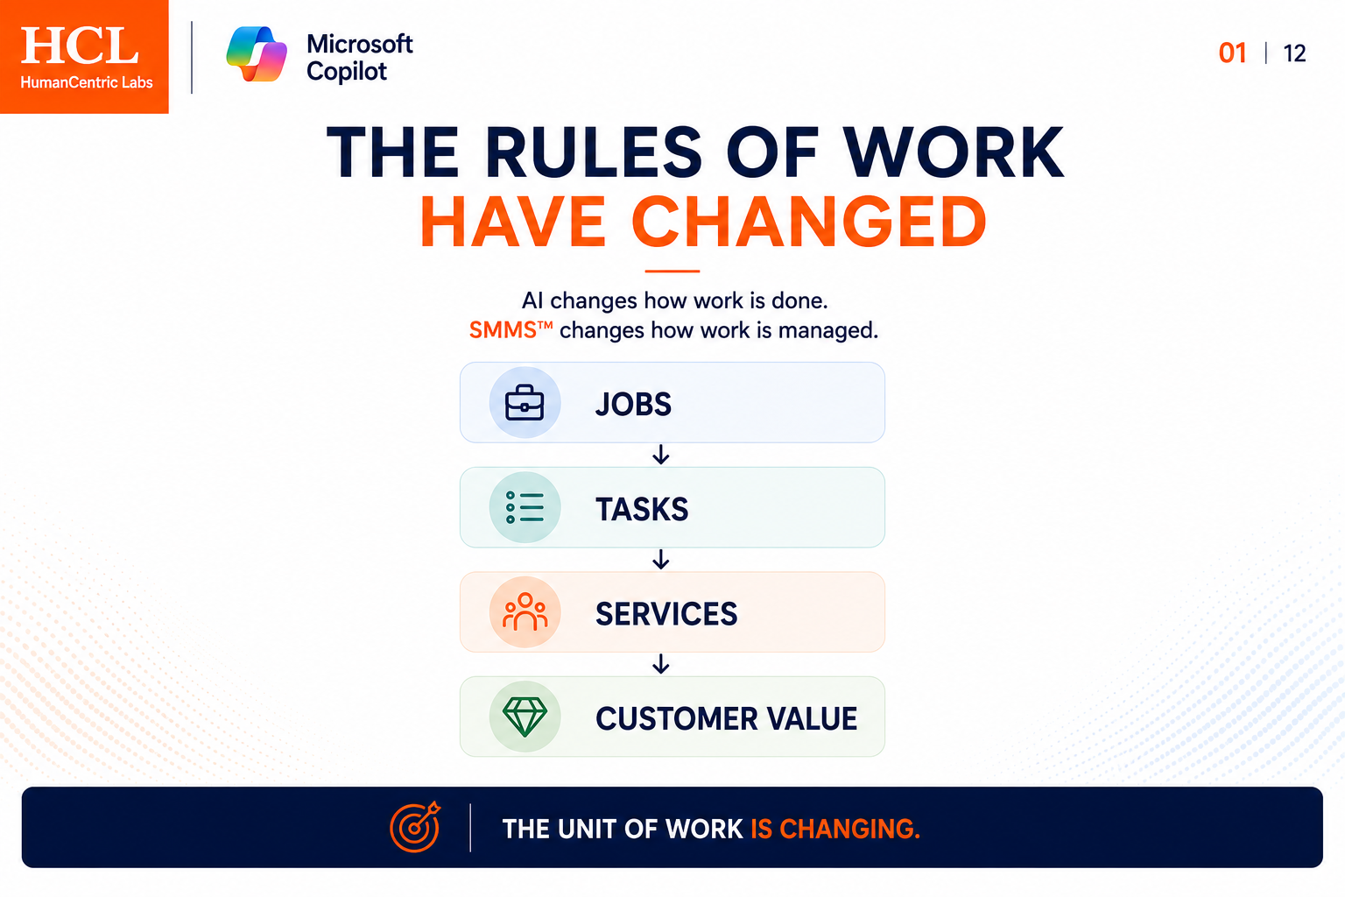

Slide 2
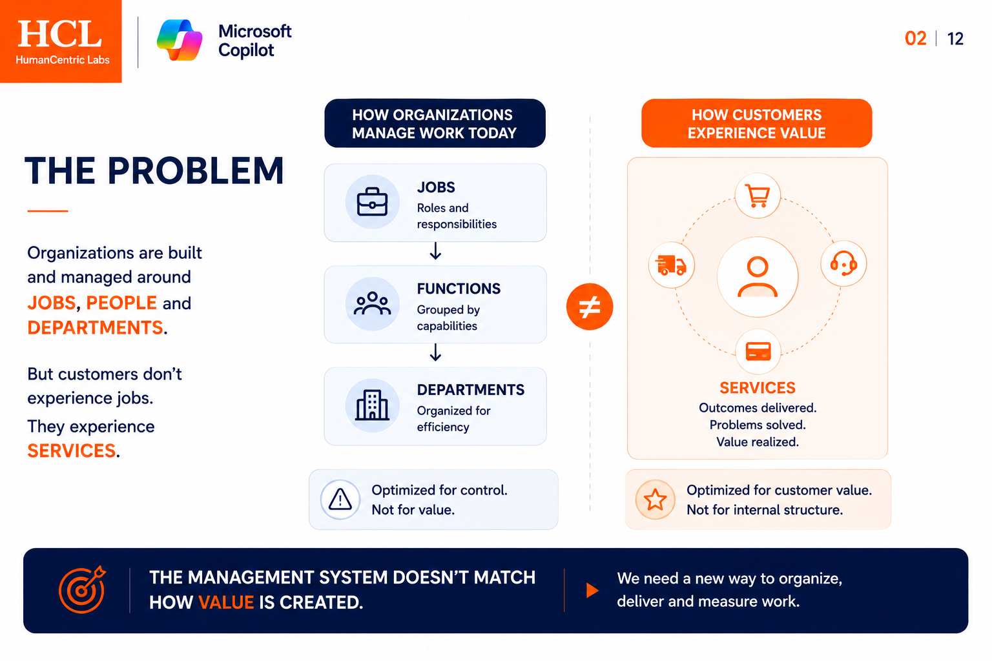
provided
Organized by Job roles
Focused on plans, control, outcomes
ALIGN WITH

Slide 3
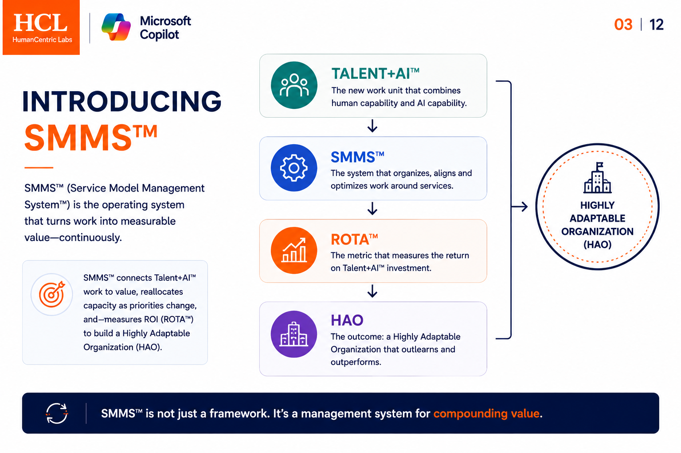
That

Slide 4
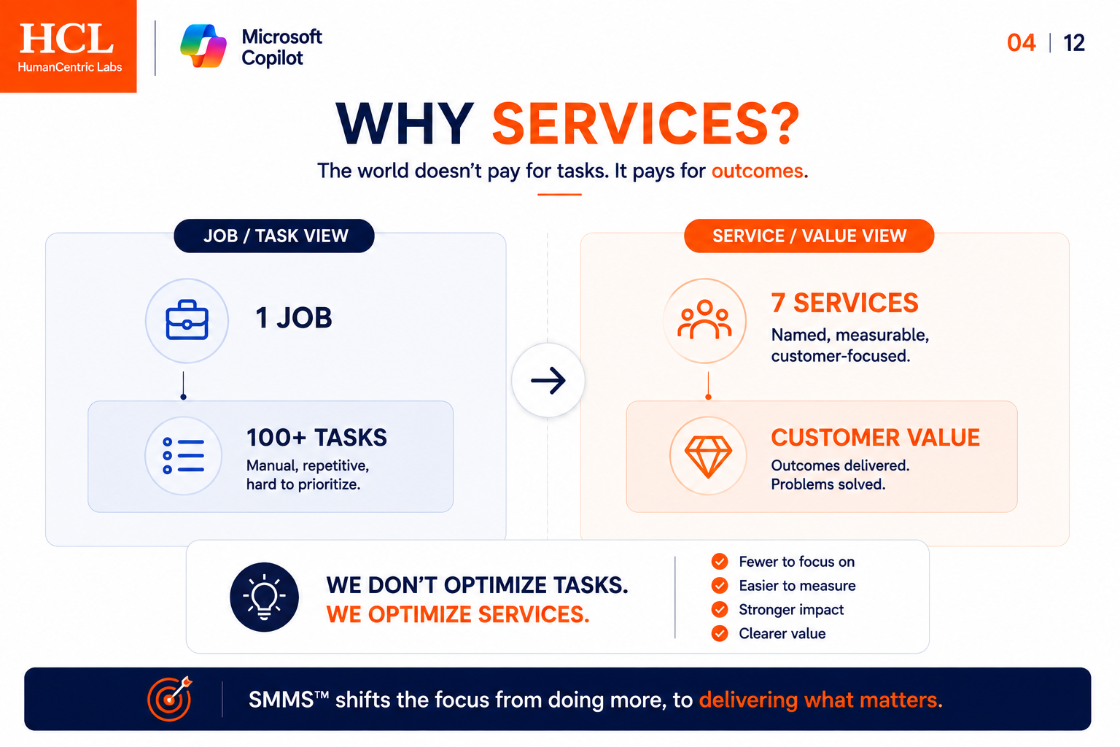
- Customer focus
- Measure value
- Adaptive process
- Service value metric

Slide 5
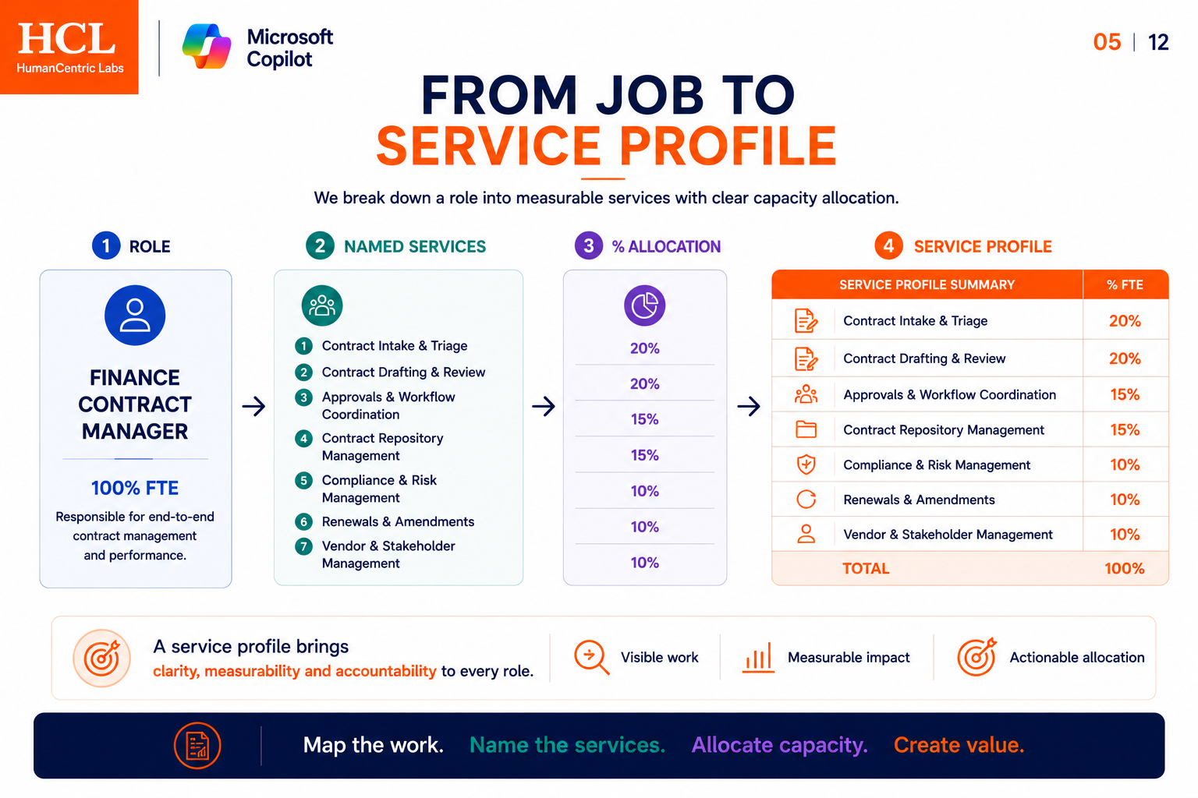
FTE

Slide 6
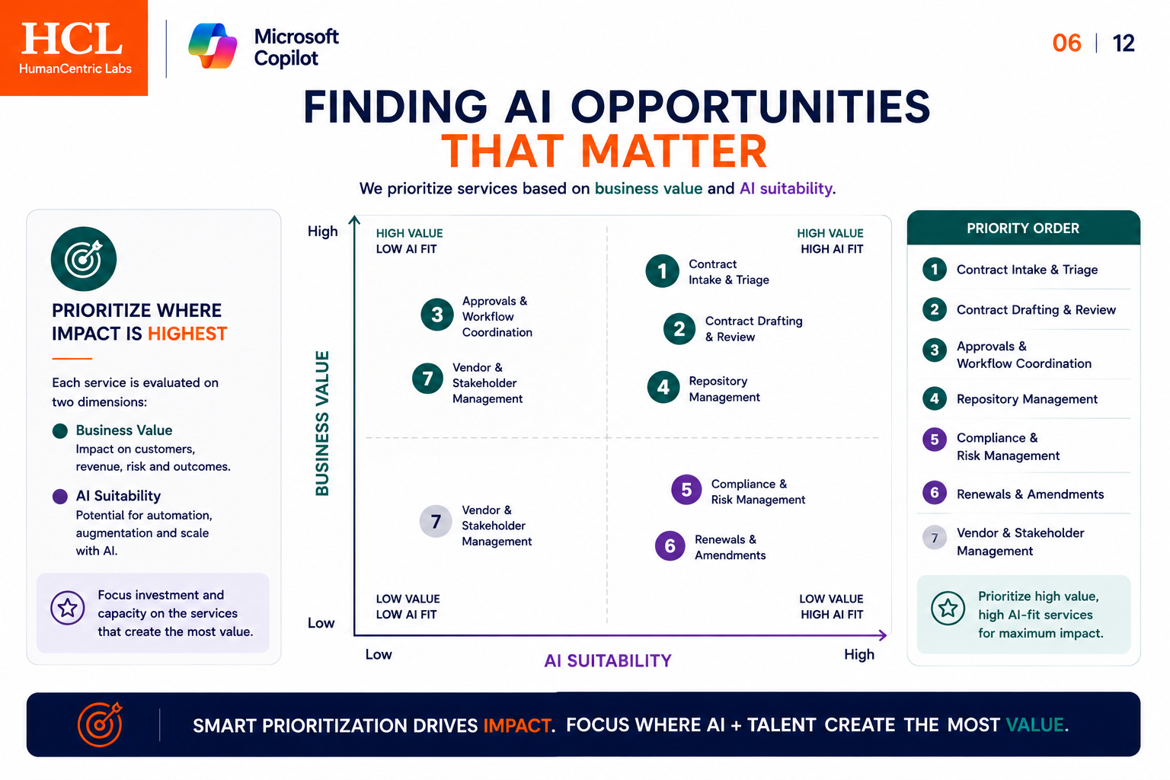
Great slide
- Talent and AI

Slide 7
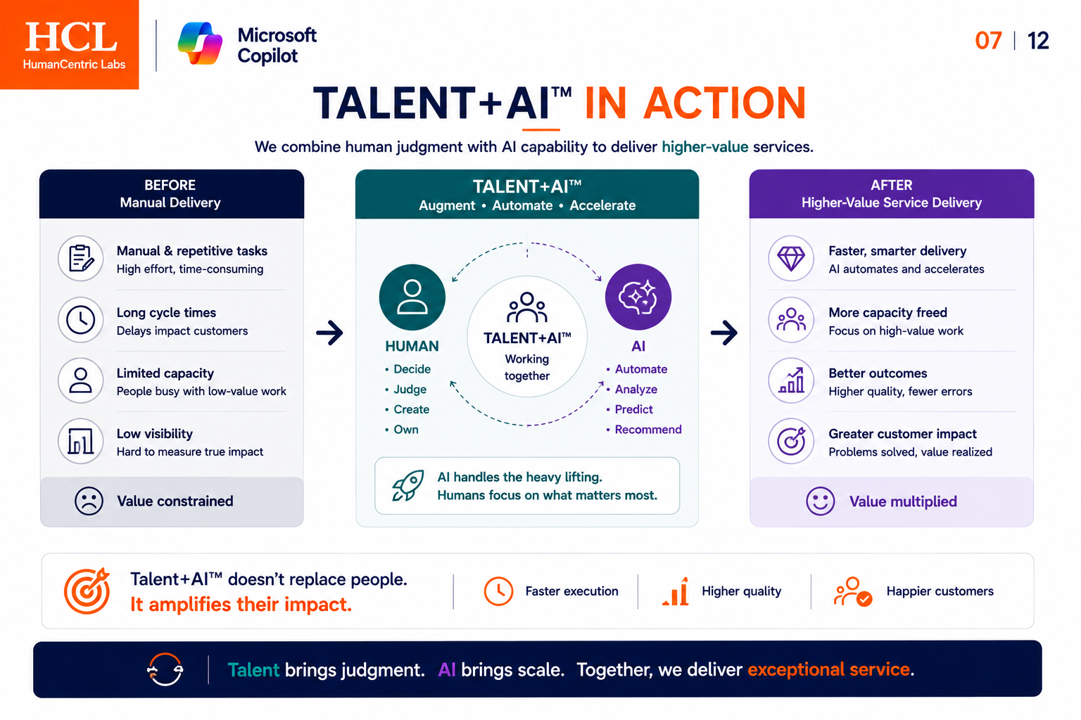
Great slide

Slide 8
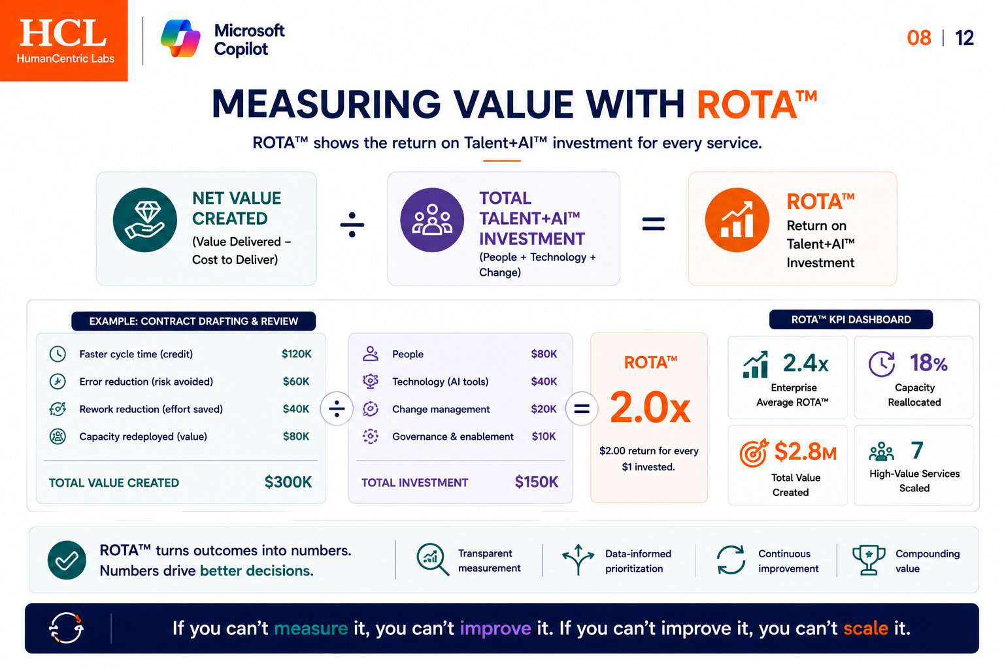
Small font
What use case?
What use case?

Slide 9
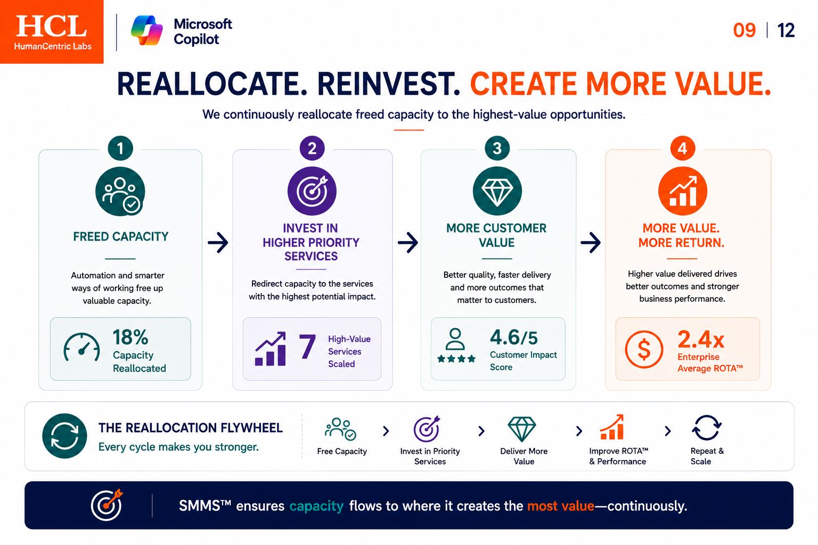
What use case?

Slide 10
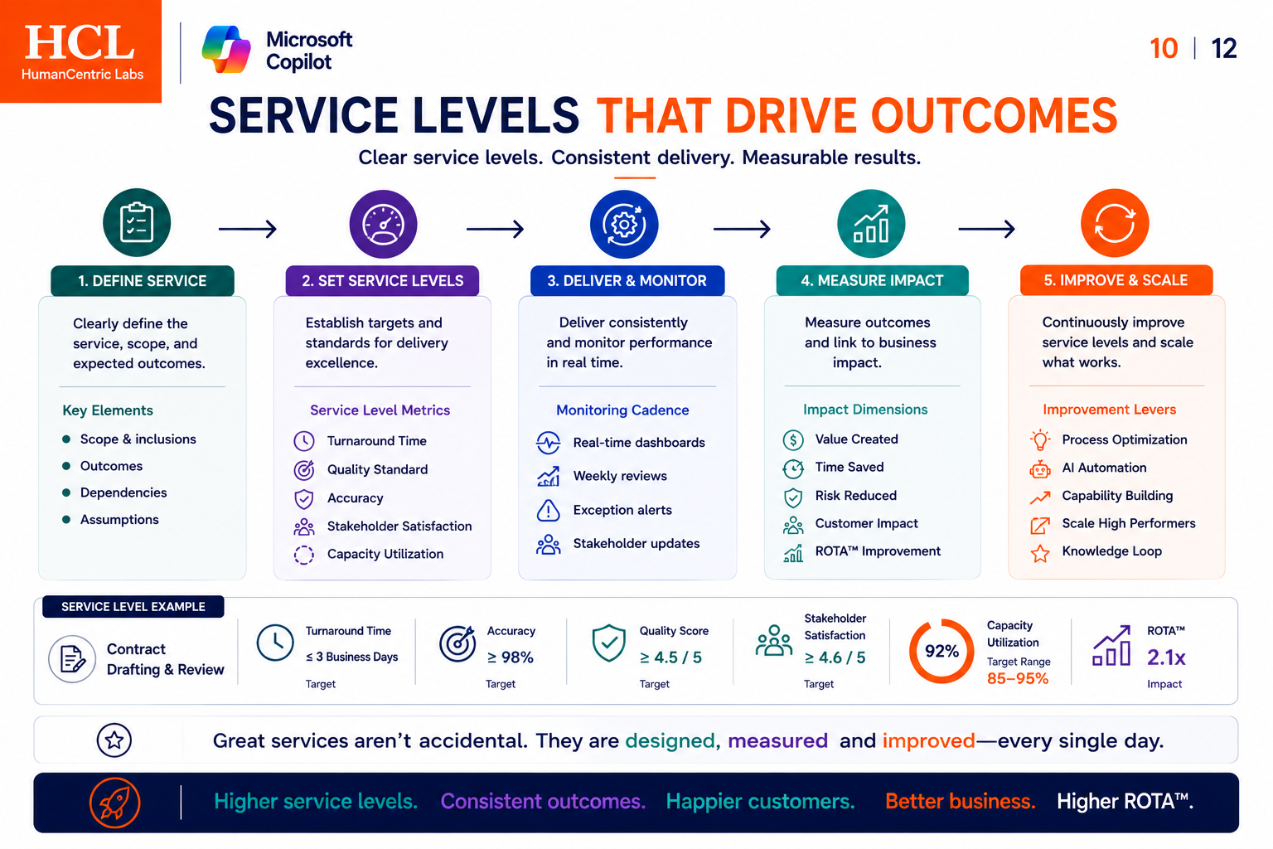
Great slide

Slide 11
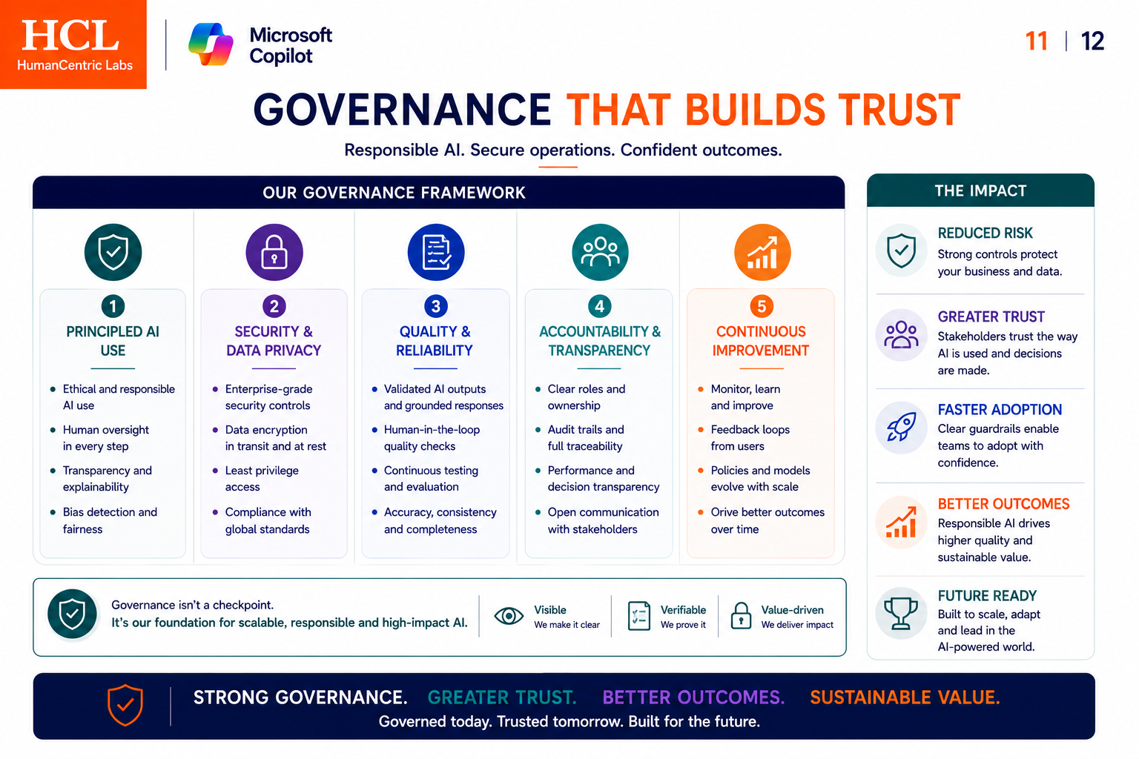

Slide 12
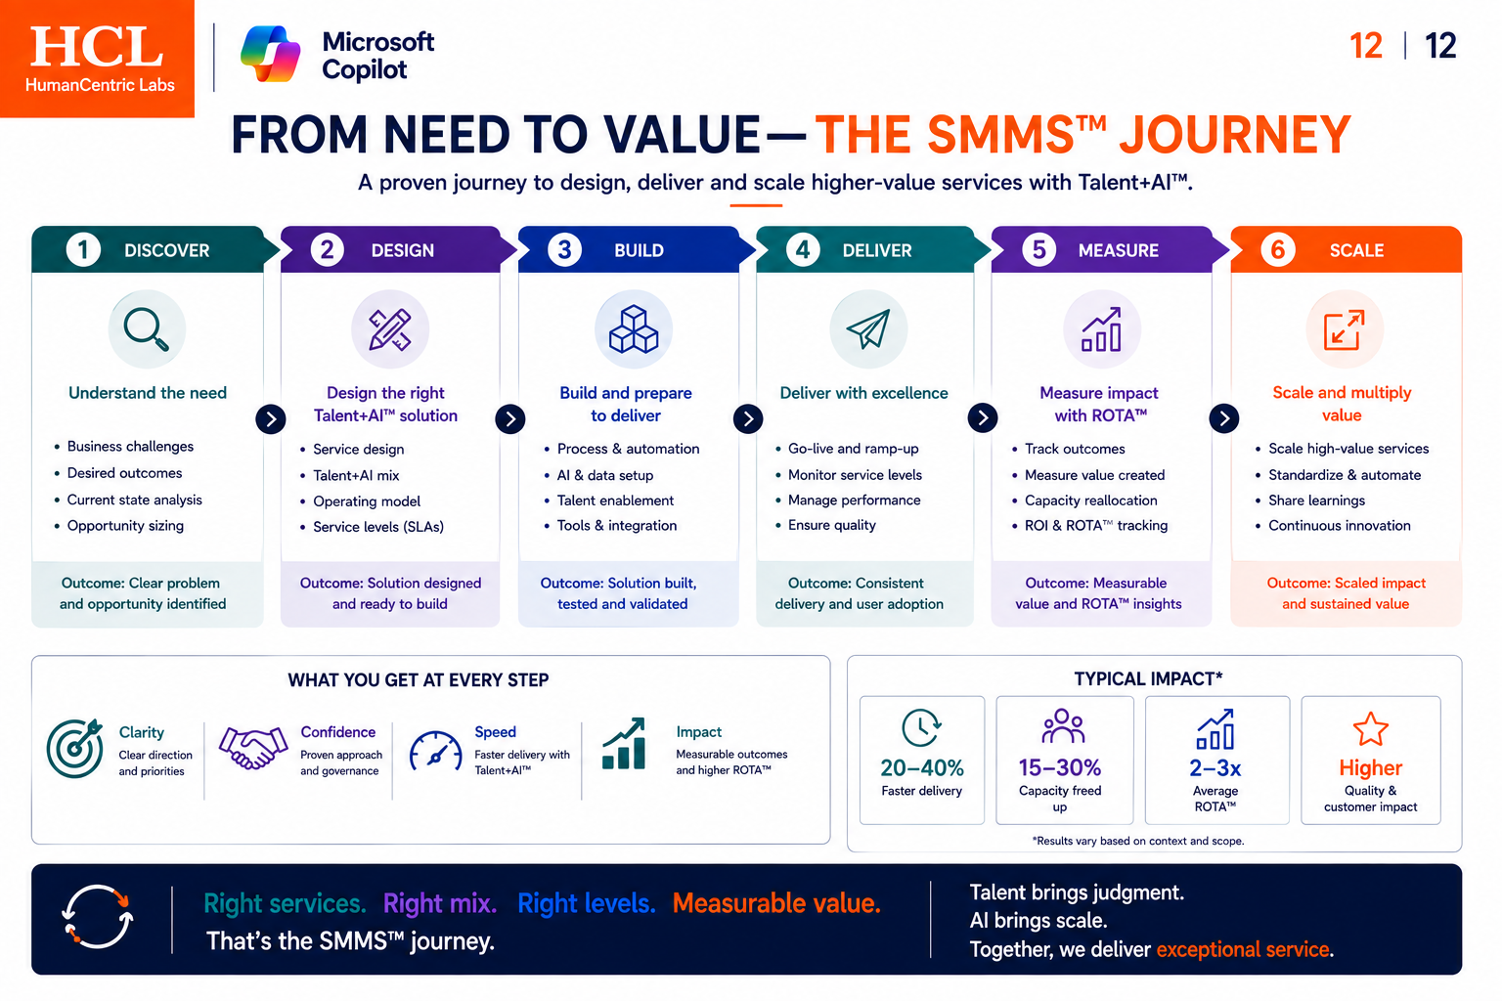

Slide 13
Summary
What about adaptability Quarterly Review and Learn, key milestone to achieve HAO (I can help to feed into LLM) Attributes of an HAO – The Journey

